Slide 1
Ch – 2 Determining Your SEO Objectives & Defining Your Site’s Audience First Stages Of SEO

Slide 2
Content :
Setting SEO Goals and Objectives
Developing an SEO Plan Prior to site Development
Understanding Audience & Finding Niche
SEO for Raw Traffic
SEO for E-Commerce Sales
SEO for Mindshare / Branding
SEO For Lead Generation and Direct Marketing
SEO for Reputation Management
SEO for Ideological Influence

Slide 3
The Major Elements Of planning
Identifying site development process & players
Defining sites’s information Architecture
Auditing an Existing site to identify SEO Problem
Identifying current server statics software
Determining top Competitors
Assessing Historical Progress

Slide 4
Benchmarking Current Indexing Status
Benchmarking Current Ranking
Benchmarking Current Traffic Source & Volume
Leveraging Business Assets For SEO
Combining Business Assets and Historical Data to Conduct SEO / Website SWOT Analysis……..

Slide 5
Setting SEO Goals & Objective :
SEO , Once a Highly Specialized Task Relegated To The Back Rooms , of a web site development team , is now a mainstream marketing activity….
This dramatic rise can be attributed to three emerging teams :

Slide 6
Business can earn significant revenues by leveraging the quality and relevance of this for direct sales , customer acquisition and awareness campaigns…
Visibility in search engines creates an implied where searcher associate quality , relevance with sites that rank highly for their query..
Dramatic growth in the interaction between offline and online marketing necessitates investment by organization of all kind in a successful search strategy..

Slide 7
Developing an SEO Plan Prior to Site Development :
It is widely understood in the industry that search engine optimization should be built in , as early as possible to the entire site development strategy from choosing a Content Management System (CMS) and planning site architecture to on page content development.

Slide 8
SEO plans have many moving parts , and SEO decision can have a significant impact on other department such as development , other marketing groups and sales…
Getting that inputs as soon as possible will bring the best result for a business at the least possible cost…

Slide 9
Understanding Your Audience & Finding Your Niche :
A nontrivial part of an SEO plan is figuring out who you are targeting with your website.
This is not always that easy to determine.
As you will see in this section , many factors enter into this including the competition , the particular strengths or weakness of your own company and more……

Slide 10
Mapping your products and Services : As we outlined in the preceding section a , critical SEO activity is to understand who is searching for what you trying to promote , which requires understanding all aspects of your offering…
You also should consider business development and the company’s expansion strategy at the outset of the SEO planning process..

Slide 11
Segmenting Your Site's Audience : This is very important background information for the SEO practitioner .
For example : Site A may be a website that sells gadgets.
As a result the site’s developers go out and implement a brilliant campaign to rank for the terms they consider relevant.

Slide 12
SEO for Row Traffic :
Optimizing a site for search engines and creating keyword targeted content helps a site rank for key search terms.
Which typically leads to direct traffic and referring links as more and more people find , use , and enjoy what your produced…
Thousand of site on the web leverage this traffic to serve adverting , directly monetizing the traffic sent from the engine…

Slide 13
Here are some factors to think about when considering SEO for raw traffic :
-> When to Employ : Use it when you can monetize traffic without actions or financial transaction on your site …
-> keyword targeting :keyword targeting in this scenario can be very broad..
-> Page & content creation :you also need to employ good on page creation (title , headlines , internal linking etc..)

Slide 14
SEO For E- Commerce Sales :
One of the most direct monetization strategies for SEO is driving relevance traffic to an e – commerce shop to boost sales..
Here are some factors to think about when considering SEO for E- Commerce Sales :
-> When to Employ : Use it when you have product / services that are directly for sale on your website…

Slide 15
-> keyword targeting : your often find that more specific the query brand inclusive , product inclusive & so on the more likely the visitor are to make the purchase…
-> Page & content creation : Manual link building is an option here , but scalable strategies that leverage a company or customers can be equally or even more , valuable…

Slide 16
SEO for Mindshare/ Branding :
A less popular but equally powerful application of SEO is the its use for branding purpose…
Bloggers , social media community website , content producers , news outlets , and dozens of other web publishing…
Here are some factors to think about when considering SEO for mindshare / branding :

Slide 17
-> When to Employ : Use it when branding , or communicating a message , is your goal …
-> keyword targeting : A keyword focus is less critical here your likely have a few broad terms that receive the more achievable and the better target..
-> Page & content creation : Make an accessible site , use good link structure , apply best practices , and focus on links for domain authority rather than specific keywords…

Slide 18
SEO For Lead Generation and Direct Marketing :
Although lead generation via the Web is less direct than an ecommerce transaction.
It is arguably just as valuable and important for building customers, revenue, and long-term value.
Millions of search queries have commercial intents that can’t be (or currently aren’t) fulfilled directly online.

Slide 19
Here are some factors to think about when considering SEO for lead generation and direct marketing:
When to employ : Use it when you have a non-ecommerce product/service/goal that you want users to accomplish on your site or for which you are hoping to attract inquiries/direct contact over the Web.
Keyword targeting : As with ecommerce, choose phrases that convert well, have reasonable traffic, and have previously performed

Slide 20
Page and content creation/optimization :
Although you might think it would be easier to rank high in the SERP for lead-generation programs than for ecommerce, it is often equally challenging.

Slide 21
SEO for Reputation Management :
Since one’s own name—whether personal or corporate—is one’s identity, establishing and maintaining the reputation associated with that identity is generally of great interest.
Imagine that you search for your brand name in a search engine, and high up in the search results is a web page that is highly critical of your organization.

Slide 22
SEO for reputation management is a process for neutralizing negative mentions of your name in the SERPs.
You may accomplish this using social media, major media, bloggers, your own sites and subdomains, and various other tactics.

Slide 23
SEO for Ideological Influence :
For those seeking to sway public (or private) opinion about a particular topic, SEO can be a powerful tool.
By promoting ideas and content within the search results for queries likely to be made by those seeking information about a topic, you can influence the perception of even very large groups.

Slide 24
Here are some factors to think about when considering SEO for ideological influence:
When to employ : Use it when you need to change minds or influence decisions/thinking around a subject.
Keyword targeting : It’s tough to say for certain, but if you’re engaging in these types of campaigns, you probably know the primary keywords you’re chasing and can use keyword research query expansion to find others.

Slide 25
The Major Elements Of planning :
As any experienced SEO consultant will tell you, you should incorporate your SEO strategy into the site planning process long before your site goes live.
Your strategy should be well outlined before you make even the most basic technology choices, such as the hosting platform and your CMS.

Slide 26
Regardless of when you start, there are a number of major components to any SEO plan that you need to address long before you research the first title tag.
Technology Choices :
As we already suggested, SEO is a technical process, and as such, it impacts major technology choices.
For example, a CMS can facilitate—or, possibly, undermine—your SEO strategy.

Slide 27
Market Segmentation :
Another critical factor to understand is the nature of the market in which you are competing.
In some markets, natural search is intensively competitive. December 2012 Google results for credit cards.
In this market, Visa, MasterCard, American Express, and Discover all fail to make the #1 position in Google’s results, suggesting that the market is highly competitive.

Slide 28
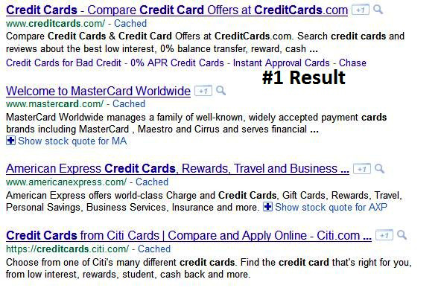

Slide 29
Branding Considerations :
Of course, most companies have branding concerns as well.
Competition :
Your SEO strategy can also be influenced by your competitors’ strategies, so understanding.
what they are doing is a critical part of the process for both SEO and business intelligence objectives……

Slide 30
Identifying site development process & players :
Before you start the SEO process, it is imperative to identify who your target audience is, what your message is, and how your message is relevant..
There are no web design tools or programming languages that tell you these things.
Advertising messages need to be well thought out and prepared.

Slide 31
You do not want your team bickering over whether to optimize for “hardcore widget analysis” or “take your widgets to the next level.
Ongoing feedback is essential because the success of your project is determined solely by whether you’re meeting your goals.
A successful SEO team understands all of these interactions and is comfortable relying on each team member to do his part.
Establishing good communication among team members is essential.

Slide 32
Defining Your Site’s Information Architecture :
Whether you’re working with an established website or not, you should plan to research the desired site architecture (from an SEO perspective) at the start of your SEO project.
This task can be divided into two major components: technology decisions and structural decisions.

Slide 33
Technology Decisions : your technology choices can have a major impact
on your SEO results. The following is an outline of the most important issues to address at the outset:
Dynamic URLs : Although Google now states that dynamic URLs are not a problem for the company, this is not entirely true, nor is it the case for the other search engines.

Slide 34
Session IDs or user IDs in the URL :
It used to be very common for CMSs to track individual users surfing a site by adding a tracking code to the end of the URL.
Superfluous flags in the URL : This probably does not bother Google, but it may bother the other search engines, and it interferes with the user experience for your site.

Slide 35
Links or content based in JavaScript, Java, or Flash : Search engines often cannot see links and content implemented using these technologies.
Make sure the plan is to expose your links and content in simple HTML text.
Content behind forms (including pull-down lists) : Making content accessible only after the user has completed a form (such as a login) or made a selection from an improperly implemented pull-down list is a great way to hide content from the search engines.

Slide 36
Structural Decisions : One of the most basic decisions to make about a website concerns internal linking and navigational structures….

Slide 37
Auditing an Existing Site to Identify SEO Problems :
Auditing an existing site is one of the most important tasks that SEO professionals encounter.
SEO is still a relatively new field, and many of the limitations of search engine crawlers are non-intuitive.
In addition, many web developers, unfortunately, are not well versed in SEO.

Slide 38
Even more unfortunately, some stubbornly refuse to learn, or, worse still, have learned the wrong things about SEO.
This includes those who have developed CMS platforms, so there is a lot of opportunity to find problems when conducting a site audit.

Slide 39
Identifying Current Server Statistics Software :
we will discuss in detail the methods for tracking results and measuring success, and we will also delve into how to set a baseline of measurements for your SEO projects.
But before we do that, and before you can accomplish these tasks, you need to have the right measurement systems in place.

Slide 40
Web Analytics
Logfile Tracking
Search Analytics

Slide 41
Determining Top Competitors :
Understanding the competition should be a key component of planning your SEO strategy.
The first step is to understand who your competitors in the search results really are.
It can often be small players who give you a run for your money.

Slide 42
For example, consider the previously
mentioned credit card search in Google Visa, MasterCard, position in the Google results.
Affiliates tend to be the most adept at search engine optimization and can be the most lax in abiding by the search engines’ terms and Condition….

Slide 43
Assessing Historical Progress :
Measuring the results of SEO changes can be challenging, partly because there are so many moving parts and partly because months can elapse between when changes are made to a site and when results are seen in search rankings and traffic.
This difficulty only increases the importance of measuring progress and being accountable for results.

Slide 44
This section will explore methods for measuring the results from your SEO efforts…

Slide 45
Benchmarking Current Indexing Status :
The search engines have an enormous task: that of indexing the world’s online content—well, more or less.
The reality is that they try hard to discover all of it, but they do not choose to include all of it in their indexes.
When you launch a new site or add new sections to an existing site, or if you are dealing with a very large site, not every page will necessarily make it into the index.

Slide 46
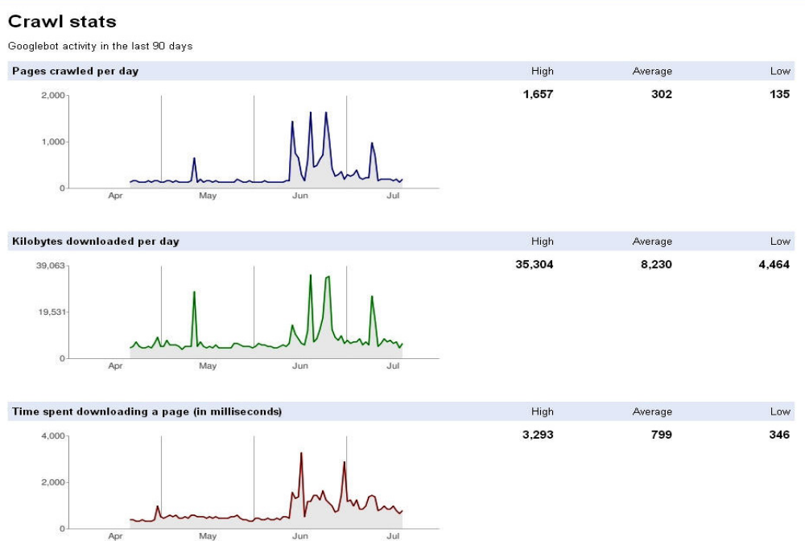

Slide 47
To get a handle on this you will want to actively track the indexing level of your site.
Keeping a log of the level of indexation over time can help you understand how things are progressing.
Related to indexation is the crawl rate of the site.

Slide 48
Benchmarking Current Rankings :
Many companies want to use this as a measurement of SEO progress over time, but it is a bit problematic, for a variety of reasons.
Here is a summary of the major problems with rank checking :
- Google results are not consistent:
- Different geographies (even in different cities within the United States) often give different results.
- Different data centers give different results.

Slide 49
Benchmarking Current Traffic Sources and Volume :
The most fundamental objective of any SEO project should be to drive the bottom line.
For a business, this means delivering more revenue with favorable ROI.
As a precursor to determining the level of ROI impact, the SEO practitioner must focus on increasing the volume of relevant traffic to the site.

Slide 50
More relevant traffic should mean more revenue for the business….
Today’s web analytics tools make the gathering of such data incredibly easy..
Google Analytics (http://www.google.com/analytics) and Yahoo! Web Analytics (http://web.analytics.yahoo.com)

Slide 51
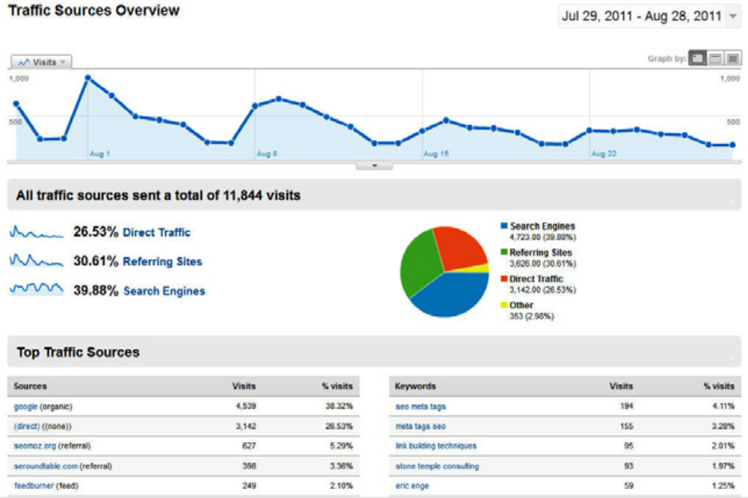

Slide 52
Leveraging Business Assets for SEO :
Chances are your company/organization has a lot of valuable commodities beyond the website that can be put to good use to improve the quality and quantity of traffic you receive through search engine optimization efforts.
We discuss some of these things in the subsections that follow.

Slide 53
Other Domains You Own/Control
Partnerships On and Off the Web
Customers Who Have Had a Positive Experience

Slide 54
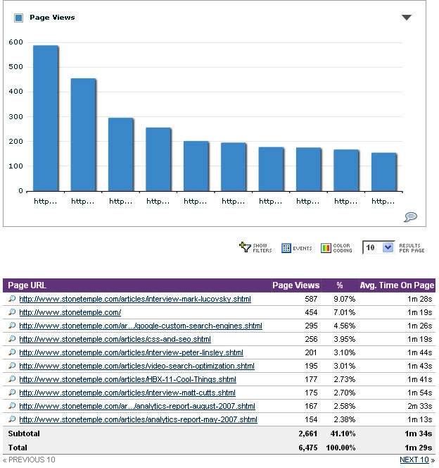

Slide 55
Combining Business Assets and Historical Data to Conduct SEO/ Website SWOT Analysis
A classic staple of business school is the SWOT analysis—identifying the strengths, weaknesses, opportunities, and threats faced by a business or project.
By combining data from your business asset assessment and historical tracking data (and visitor analytics), you can create some very compelling analyses of your organization and its marketplace…

Slide 56
Identifying strengths is typically one of the easier objectives:
• What sources of traffic are working well for your site/business?
• Which projects/properties/partnerships are driving positive momentum toward
traffic/revenue goals?
• Which of your content sections/types produces high traffic and ROI?

Slide 57
Determining the weaknesses can be tougher (and takes more intellectual honesty and courage):
• What content is currently driving low levels of search/visitor traffic?
• Which changes that were intended to produce positive results have shown little/no value?
• Which traffic sources are underperforming or underdelivering?

